Slide 1
Converting data to friendlier formats

Slide 2
Converting Data to Friendlier Formats
Understanding Data Formats
Converting PDFs to Excel
Exercise
Converting images to text using OCCR
Searching for data to convert
Exercise
Summary & Resources

Slide 3
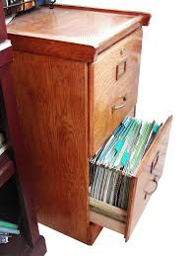
A very common data format …

Slide 4
Where is Data?
Data is Collected Every Time Something is:
Registered
Inspected
Purchased
Voted on
Surveyed

Slide 5
Converting Data to Friendlier Formats
Understanding Data Formats
Converting PDFs to Excel
Exercise
Converting images to text using OCCR
Searching for data to convert
Exercise
Summary & Resources

Slide 6
Understanding Data Formats
Portable Document Format (PDF): charts that contain data but are saved in a unified document with text
Excel file (xls): data is saved as a table readable by Microsoft Excel
Comma separated values (CSV): Plain text file with each data separated by a comma

Slide 7
Understanding Data Formats
Machine readable structured
CSV (comma-separated values) or TSV (tab-separated values), Excel (.xls)
Unstructured
(PDF, Word) and bitmap images (GIF, JPEG, PNG, BMP)

Slide 8
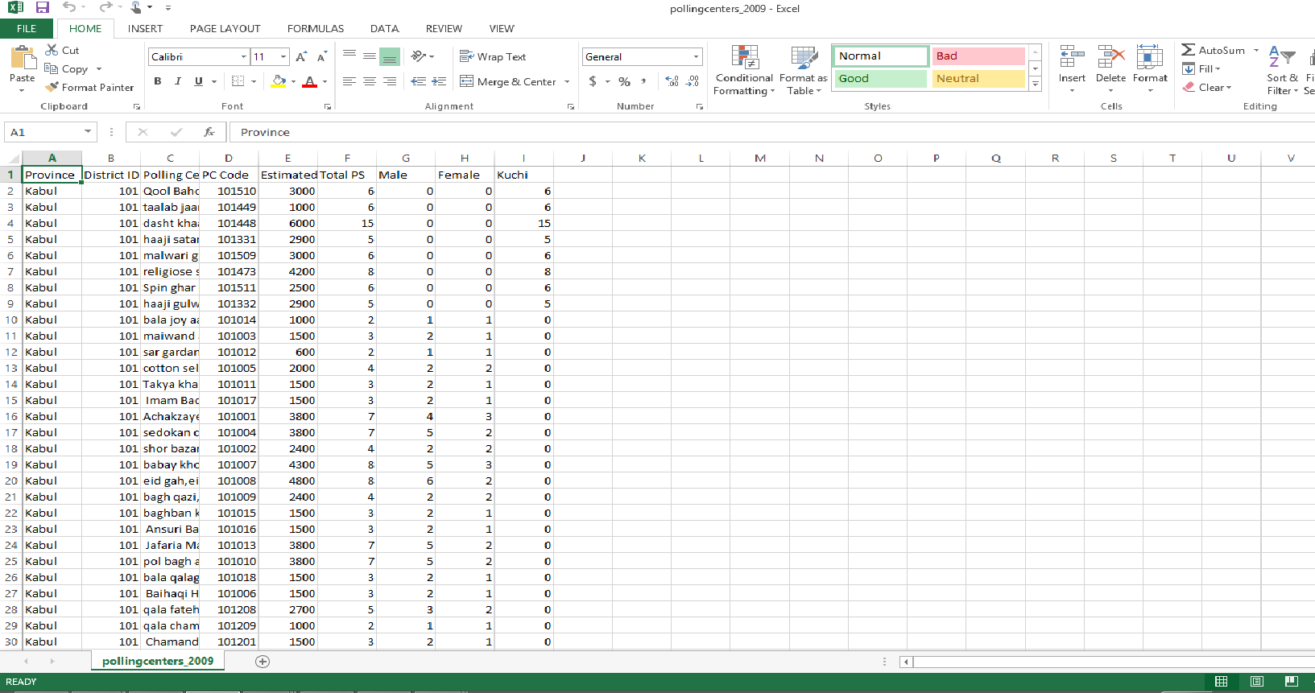
Understanding Data Formats: Machine Readable

Slide 9
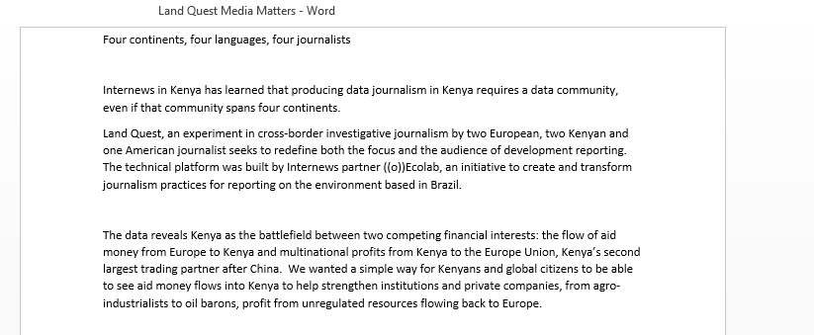
Understanding Data Formats Unstructured

Slide 10
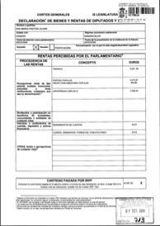
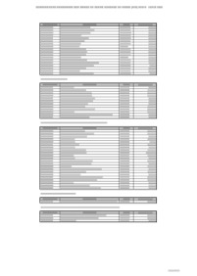
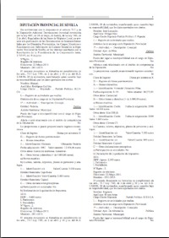
Understanding Data Formats
PDFs
Scanned Images (Unstructured, not searchable)
Computer-generated (searchable)
Tables (Structured, searchable)
Complex formats (Unstructured, searchable)

Slide 11
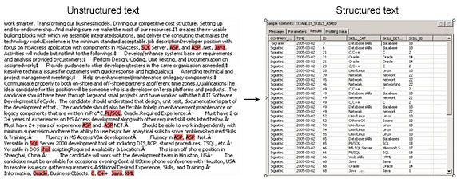
Understanding Data Formats: Unstructured
For example. A script might extract the text after “Name:” and put the text that follows into a column on a spreadsheet with the column header “Name”

Slide 12
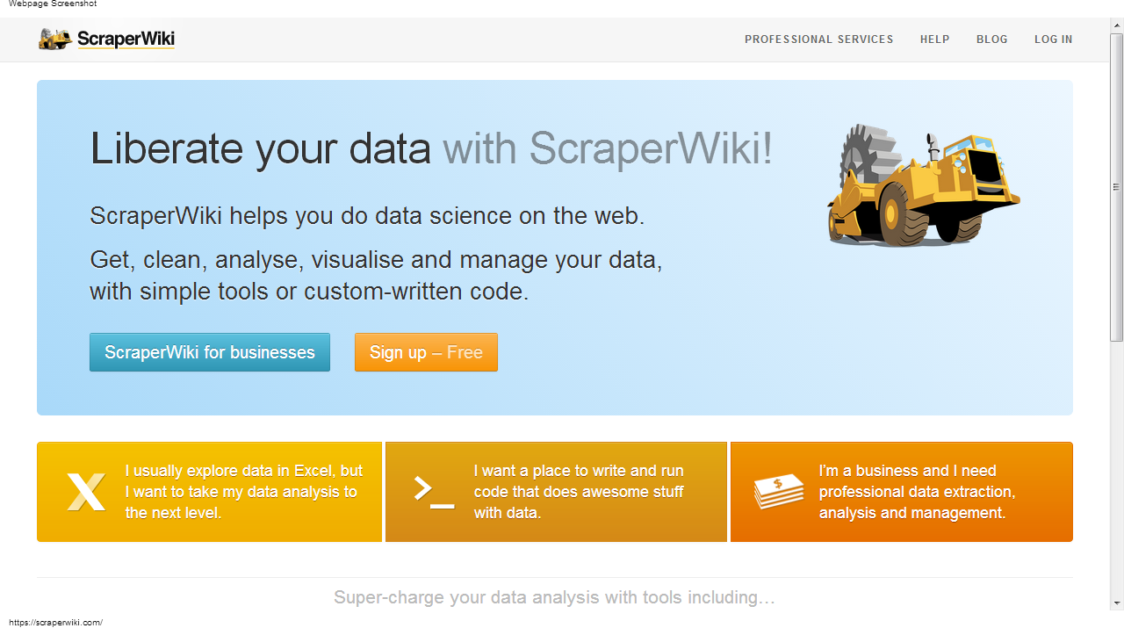
Understanding Data Formats: Unstructured: Scraper Wiki

Slide 13
Converting Data to Friendlier Formats
Understanding Data Formats
Converting PDFs to Excel
Exercise
Converting images to text using OCCR
Searching for data to convert
Exercise
Summary & Resources

Slide 14
Converting PDFs to Excel
Copying and pasting into Excel does not usually work
Free online tools for data in English:
cometdocs.com
pdftoexcelonline.com
zamzar.com
pdftoexcel.org
Free desktop software
tabula.nerdpower.org

Slide 15
Converting Data to Friendlier Formats
Understanding Data Formats
Converting PDFs to Excel
Exercise
Converting images to text using OCCR
Exercise
Searching for data to convert
Exercise
Summary & Resources

Slide 16
Converting PDFs to Excel: Exercise
Open the File: Maternal Health Care Trends Afghanistan
Where does the data come from
What year is it from?
What pages have data tables that we are interested in?
Go to http://www.splitpdf.com/
Click on “My computer” or “Google Drive.”
Select pages 14-15
Click “Split!”
The document should open automatically to save

Slide 17
Converting PDF to Excel: Exercise
Go to Cometdocs.com
Upload your file
Drag the file into the “Convert” box
Select “to Excel”
Enter your e-mail address
You should receive an e-mail when your document is ready
Also try:
zamzar.com
pdftoexcelonline.com
zamzar.com
pdftoexcel.org

Slide 18
Converting Data to Friendlier Formats
Understanding Data Formats
Converting PDFs to Excel
Exercise
Converting images to text using OCCR
Searching for data to convert
Exercise
Summary & Resources

Slide 19
Converting PDF to Excel: Exercise
Open Afghanistan Provincial Health Profiles
Extract the pages for the province you are interested in.
Convert the data tables to PDF.

Slide 20
Converting Data to Friendlier Formats
Understanding Data Formats
Converting PDFs to Excel
Exercise
Converting images to text using OCCR
Searching for data to convert
Exercise
Summary & Resources

Slide 21
Understanding Data Formats: Scanned Images
Optical Character Recognition Software
For documents that you can’t search or select text
Quality depends on quality of image, clarity of text
Adobe Acrobat Professional: paid
Google Docs: free
Document Cloud: free. Advantage is that it allows you to annotate and publish your document as part of a multimedia publication. Your media outlet must request an account.

Slide 22
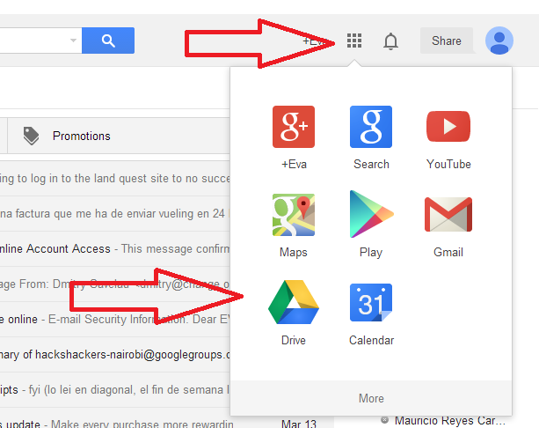
Understanding Data Formats: Scanned Images Exercise
Open and save AfghHealthIndicators Factsheet
Open Google Drive (click on grid in the top right corner of G-mail and select Drive)

Slide 23
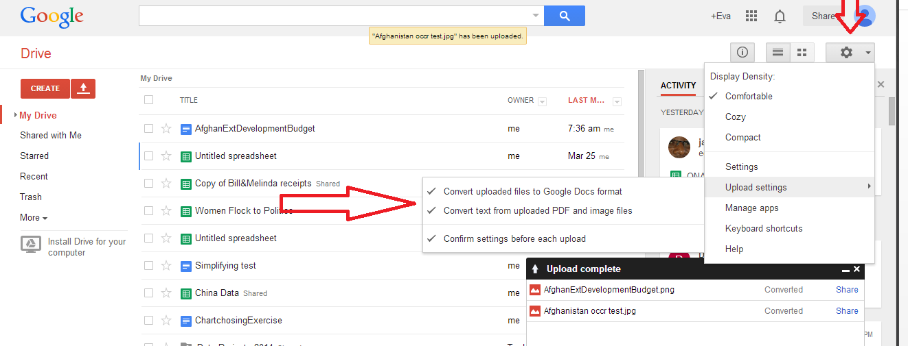
Understanding Data Formats: Scanned Images Exercise
3. Go to Setting and Upload Settings: Select all options

Slide 24
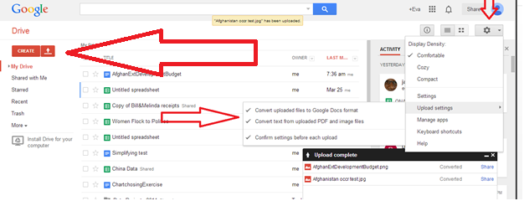
Understanding Data Formats: Scanned Images Exercise
4. Next to the Create button, click on the Upload button
5. Select your PDF or Image file
6. Once the file is uploaded it should appear on your drive with both the image and any text that Google was able to extract.

Slide 25
Converting Data to Friendlier Formats
Understanding Data Formats
Converting PDFs to Excel
Exercise
Converting images to text using OCCR
Searching for data to convert
Exercise
Summary & Resources

Slide 26
Searching for data to convert
Filetype search (PDF, XLS, CSV)
filetype:pdf
Website search
site:http://www.who.int/

Slide 27
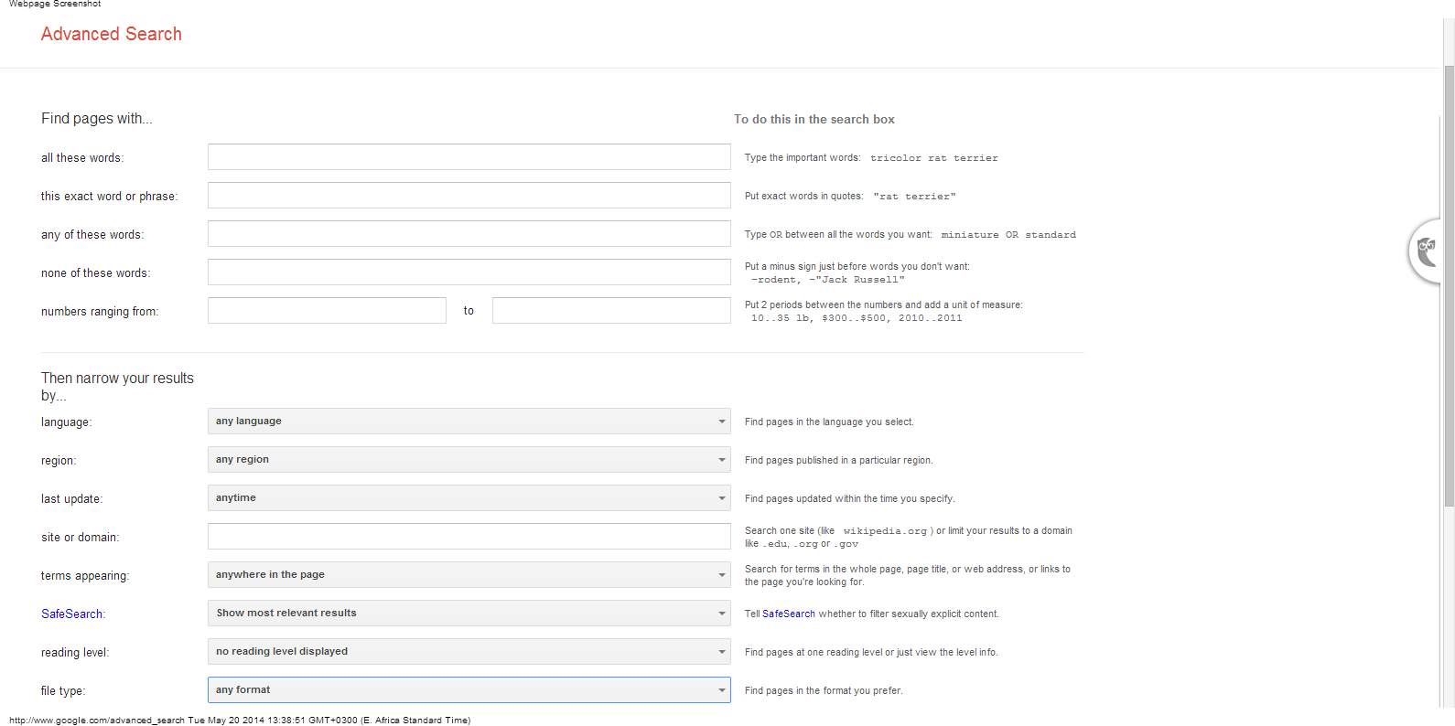
Searching for Data to Convert:
Google Advanced Searches

Slide 28
Converting Data to Friendlier Formats
Understanding Data Formats
Converting PDFs to Excel
Exercise
Converting images to text using OCCR
Searching for data to convert
Exercise
Summary & Resources

Slide 29
Converting Data Exercise
Use advanced google search to find PDFs on health in Afghanistan.
Review the data including who produced the data and what year it is from.
Scrape the data using PDF to Excel for machine-generated tables and OCCR in Google for image files.

Slide 30
Converting Data to Friendlier Formats
Understanding Data Formats
Converting PDFs to Excel
Exercise
Converting images to text using OCCR
Searching for data to convert
Exercise
Summary & Resources

Slide 31
Summary and Resources
Need help scraping your data from the web?
Ask the School of Data
Join the data driven journalism listserve
Register for a free import.io account and try it out
Try out Outwit Hub

Slide 32
Summary & Resources
Data is available in many different formats and almost always you will need to convert data to an Excel or csv file.
Every day, more data is available online and accessible through searches
If you can’t find it online, don’t give up!

